Slide 1
Educational Aide Permit Renewal
Professional Development
February 1, 2023
Leslie Butler, HR Representative-Licensure
Acynda Spriggs, Personnel Coordinator, Strategic Staffing
Notes:
Thank you for spending the next hour with us. My name is Leslie Butler and I am the HR Representative from Licensure and joining me is my Supervisor, Personnel Coordinator of Strategic Staffing, Acynda Spriggs. Today’s topic is the renewal process for the educational aide permit. If you have any questions, please put them in the chat as Acynda will be monitoring the chat. Before I begin the presentation, I would like to give away some CCS Swag.The first person to put the correct answer in the chat will win!: What date must your permit be renewed by?
Answer June 2, 2023

Slide 3
June 2, 2023
Why does CCS use the last day of school when the permit does not expire until June 30, 2023?
Notes:
CCS requires IA’s to renew their permits by the last day of the school year because most IA’s do not check their emails over the summer break. If there were any issues with renewing, these can all be resolved by the end of the year and, those IA’s that work summer school need their permit to be valid since summer runs from June through July. One more question for some CCS Swag: What is the name of the fund that requires IA’s to add the ESEA designation onto their permit?

Slide 4
Title I Funds
Title I Fund Requirements: https://codes.ohio.gov/ohio-revised-code/section-3319.074
At the start of each school year, each school district shall notify the parent or guardian of each student enrolled in the district that the parent or guardian may request information on the professional qualifications of each classroom teacher who provides instruction to the student. The district shall provide the information on each applicable teacher in a timely manner to any parent or guardian who requests it. Such information shall include at least the following:
(2) Whether a paraprofessional provides any services to the student and, if so, the qualifications of the paraprofessional.

Slide 5
Using Title I Funds
Providing services to homeless students that do not attend Title I schools;
Collaborating with child welfare agencies to ensure the educational stability of children in foster care;
Developing and implementing plans to support and improve low-performing schools identified by the state through its accountability system;

Slide 6
ESEA Designation
(Elementary & Secondary Education Act of 1965)
Because of the Title I requirement, all IA’s with the exception of the ESL IA’s are required to have the ESEA designation on their permit. This requirement deadline was 6/4/2022. Guidelines state that your permit should be kept at the district office and at the building.
Several IA’s still have not added this to their permit.
Notes:
The Properly-Certified-or Licensed Toolkit requires the following: Paraprofessionals • Provide evidence of meeting the requirements for proper certification 1. For a schoolwide program receiving Title I funds, the requirements apply to all paraprofessionals in that school. 2. For a program that is not schoolwide (i.e., targeted assistance), the requirements apply to all paraprofessionals being paid with Title I funds.

Slide 7
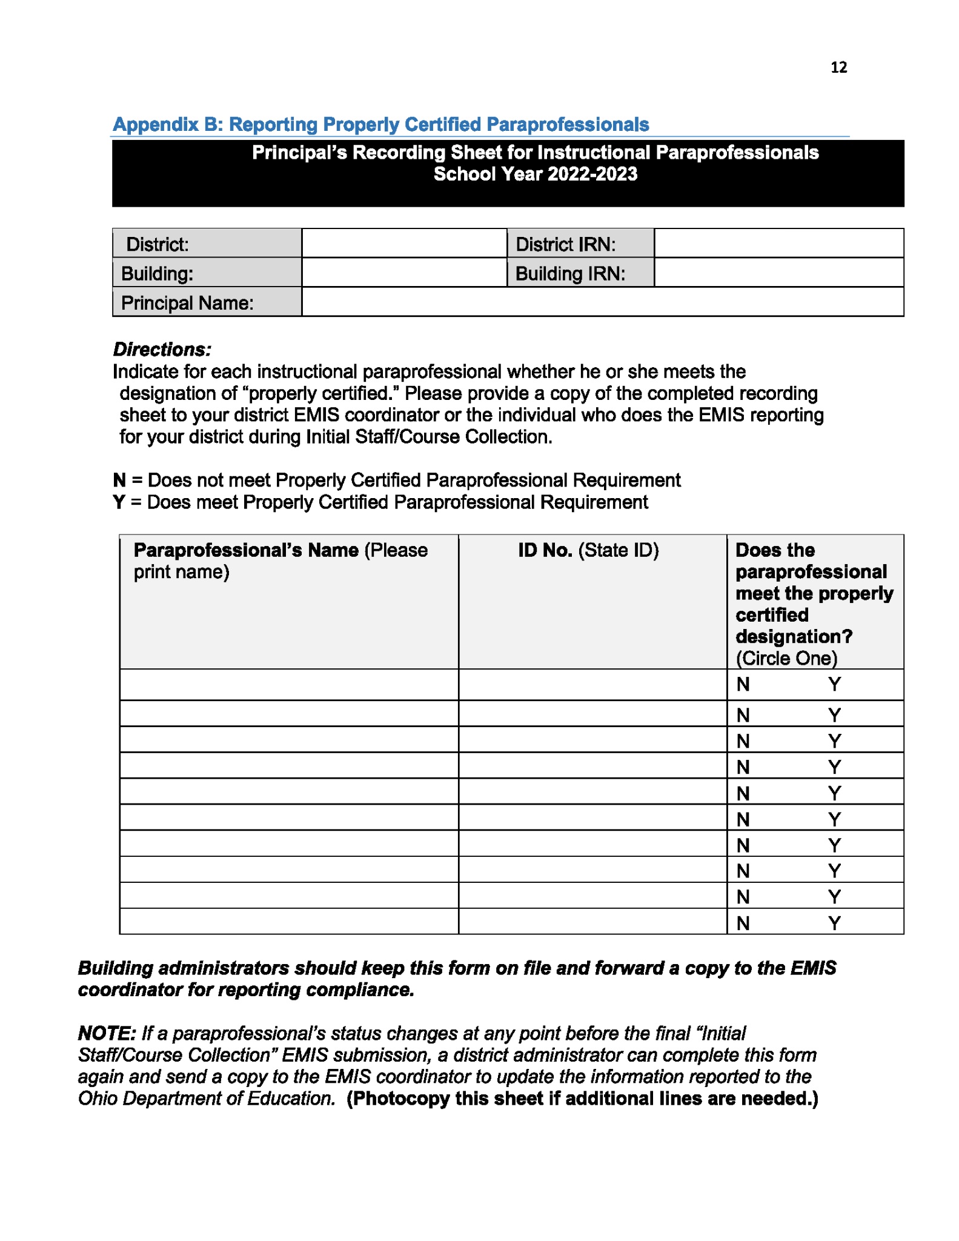
This form can be used to keep track of all IA’s permit status in each school

Slide 8
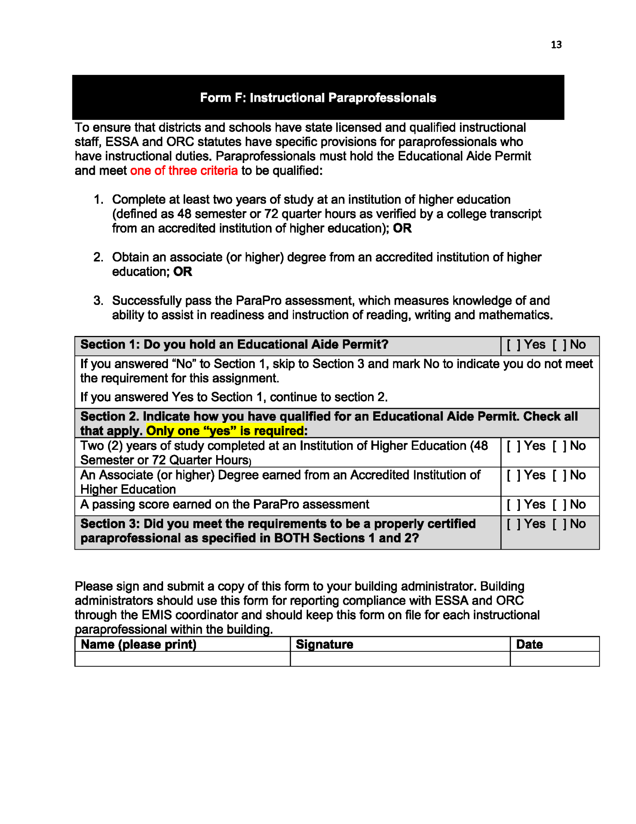
This form can be used to keep track of all IA’s permit status in each school

Slide 9
Transcript or ParaPro
If you still need your ESEA designation, please make sure you have your official transcripts or your ParaPro score before you apply.
ODE will put your application on hold for 60 days. After this date they will deny your application and charge you a $25.00 Non Refundable processing fee for application requests that do not result in issuance of a license
Notes:
If you believe that your documents are on file, please email me and I will send you what is in your file. Keep in mind that if your transcripts are not official ODE may not accept them. ODE will only send you an email one time.

Slide 10
Educator Search through ODE
You can use this webpage to look at your permit without using your login information.
https://core.ode.state.oh.us/Core4/ODE.CORE.Lic.Profile.Public.UI/

Slide 11
Accessing your ODE Profile
https://ohid.ohio.gov/wps/portal/gov/ohid/login
Those of you who have not accessed your profile in the last couple of years will need to create a new login and password. Once you follow the steps, the interface will link your old profile with the new interface.

Slide 12
Renewing your permit
You may have issues using your Iphone or Macbook when submitting your application.
You may need to disable your pop up blocker to submit your application.

Slide 13
Career Advancement
Alternative License Process: Requires a bachelor’s degree to start
Step 1 - Request an Alternative Resident Educator License Evaluation
Step 2 - Complete Content Area Exam Requirements
Step 3 - Request the Confirmation Registration Letter
Step 4 - Enroll in an Approved Alternative Licensure Institute
Step 5 - Request the Statement of Eligibility
Step 6 - Apply Online for the Alternative Resident Educator License
Step 7 - Advance to the Professional License

